Slide 1
Financial and Legal Concerns
Presented by [NAME]
Notes:
Welcome to today’s meeting. Today’s presentation is brought to you by the American Brain Tumor Association about the financial and legal aspects of having a brain tumor.
I’m [NAME] and [BACKGROUND].
Let’s get started.

Slide 2
Talking about Money
Difficult discussion
Patients don’t bring up topic
Health care teams don’t ask
Benefits of talking about money
Break down communications barriers
Lead to better care
How to bring up financial concerns
“I’m sure I’m not the first patient to have questions about the cost of treatment. Is there someone I can talk to about these questions?”
Notes:
For most patients and caregivers, talking about money is difficult. Most patients don’t want to bring it up, and many health care teams don’t ask.
On the plus side, bringing up financial questions to your health care team has a lot of advantages. It can help you break down communication barriers, and even lead to better care.
One way you can bring up your concerns about cost is to say something like,
[READ QUOTE FROM SLIDE]

Slide 3
Financial and legal concerns
Cost of brain tumor treatment
Role of health insurance
Employment and disability – your rights
Prescription assistance
Family and friends
Financial and legal resources
Notes:
In this presentation, we are going to talk about money. Specifically, we’re going to talk about
[READ LIST]

Slide 4
Costs
Most expensive of all cancers
Treatment
Craniotomy = $50,000 - $150,000
Add’l GBM treatment = $29,400 annually
Expenses for additional side effects
“Hidden” costs
Travel/transporation
Housing
Childcare
Loss of income (patient or caregiver)
Notes:
A malignant brain tumor is considered the most expensive of all cancers to treat. Even with insurance, a brain tumor diagnosis and treatment can add a significant financial burden to any family’s budget.
Why are the costs for treatment of brain tumors so high?
First, many treatments are highly specialized.
The average cost of a craniotomy is $50,000 to $150,000.
Radiation and chemotherapy costs also add up. As an example, additional treatment can be close to $30,000 per year.
For many patients, costs continue to grow as the disease progresses. Neurological and physical side effects of the brain tumor can lead to expenses such as additional services, specialists, medications and equipment.
In addition, there are many “hidden” costs of brain tumor treatment. Going to a specialized clinic may mean patients and caregivers need to travel for care, spending hundreds or more on plane tickets or gas. In addition to travel costs, there are costs for housing, childcare, as well as the loss of income from the patient or primary caregiver.

Slide 5
The good news
Fears
“If I bring up financial issues during treatment it could impact my care.”
“I might get a ‘cheaper’ treatment.”
Money is not a factor in treatment
Team treats each patient to the best of their ability
Government and private sources available
Notes:
As I’ve mentioned, it’s important to talk about money even if it’s difficult. Many patients have fears like the ones you see here. They think that if they bring up financial issues while undergoing treatment it will impact the quality of care they get. They’re afraid they could get a “cheaper” treatment, or not be treated at all.
Fortunately, this is not the case. Health care teams will treat their patients to the best of their ability despite the cost of care. In addition, there are many government and private sources available for financial help for those with brain tumors and their caregivers. We’ll get into specifics about these resources later in the presentation.

Slide 6
Health Insurance
Notes:
First, though, you’re probably wondering how insurance fits into this picture.

Slide 7
Role of insurance
Types of insurance
Employer plans (HMO, PPO)
Private insurance
Government
Medicaid
Medicare
Notes:
As you know, there are various types of insurance. The majority of Americans have an insurance plan through their employer. Other people are privately insured – meaning they pay for insurance wholly on their own. And still others receive government assistance, either via Medicaid, for people who are disabled or who have low income, or Medicare, which is available mainly for those over 65.

Slide 8
Maximizing health insurance
Print out a copy of your policy
Find people who can help
Insurance company → request case manager
Hospital/clinic → social worker
Keep careful records
Phone log
Written approvals
Check for pre-authorizations
Review bills and “Explanation of Benefits” (EOB) documents for mistakes
Notes:
As anyone who has dealt with an insurance issue knows, there can be frustrations and miscommunications about getting coverage.
You need to be proactive about getting the most out of your insurance policy.
The first thing to do, which may seem basic, is to print out a physical copy of your insurance policy. This will be helpful anytime you talk to administrators and social workers.
Next, there are several people who can help with specific insurance issues. For complex health cases, like a brain tumor, many insurance companies will assign you an insurance case manager. If they don’t, request one. This person will be your main contact throughout the process. As they become more familiar with your case, they should be able to process claims and answer questions more quickly. Another person who can help you is the hospital or clinic social worker assigned to your case. This individual usually has significant experience helping others with brain tumors navigate insurance issues.
Finally, make sure to keep careful records of phone calls, emails and written letters from both the insurance provider as well as the hospital or clinic.
This includes keeping a phone log that notes who you talked to, when and the topic of discussion.
Get written approvals from health care providers.
Check with the insurance company to see if you need any pre-authorizations for any procedures or services.
And finally, you will need to review bills from health care providers as well as EOB documents from your insurance company to make sure that what should be paid for is actually being reimbursed at the right amount.

Slide 9
Health insurance appeals
Denial of benefits
Note appeal deadlines
Resources
Social worker/financial counselor at hospital/clinic
Employer/HR rep
Legal services
National Cancer Legal Services Network (NCLSN, nclsn.org)
State insurance commissioner or consumer protection agency.
Notes:
Sometimes health claims are denied by insurance companies. If you think that the denial is wrong, your social worker or financial counselor from the hospital may be able to help.
There are often deadlines on appealing these decisions, so you’ll have to move forward in a timely manner.
If you have insurance through work, you can inform your employer or human resources representative about the denial.
Other legal resources include the National Cancer Legal Services Network (NCLSN, nclsn.org) and your state’s insurance commissioner or consumer protection agency.

Slide 10
COBRA
Continuation of employer-based insurance
18 months
60 days to choose
Costly premiums
Not always an option
Smaller companies of <20 employees
Non-profits sometimes do not have to offer
COBRA can end
Employer discontinues group coverage
Patient becomes eligible for Medicare
Notes:
What if you or your spouse leaves the job where you’re getting your insurance?
If this happens, you are eligible to receive COBRA. COBRA is a continuation of health insurance coverage that can last up to 18 months after you leave your position.
You have 60 days to decide to choose this coverage.
The reason that COBRA is often expensive is that the employee is now responsible for paying all of the premiums, when in the past the employee was probably only paying them partially.
Not all companies need to offer COBRA. Smaller companies with less than 20 people, and church-related organizations, do not need to offer COBRA.
COBRA coverage can end if your employer discontinues group health coverage or you – the patient – become eligible for Medicare.

Slide 11
Affordable Care Act (ACA)
Source for insurance coverage
www.healthcare.gov
ACA features
No pre-existing condition exclusions
Tax credits available to cover premiums
Notes:
If you are not insured when you are diagnosed and begin treatment for a brain tumor, or if for some reason your coverage ends during treatment, you will most likely want to find new insurance.
You can now do this through the Affordable Care Act website, www.healthcare.gov.
The site will walk you through the steps to choose a policy. Because of ACA,
There are no pre-existing condition exclusions. This means that it’s against the law to be denied coverage because you have a brain tumor and are currently undergoing treatment
ACA also offers tax credits to families who need them

Slide 12
Prescription Assistance
Discount programs
Target, Walmart, Walgreens
Prescription Assistance Programs (PAPs)
Needy Meds (www.needymeds.com)
Partnership for Prescription Assistance (PPA) (www.pparx.org) Rx Assist (www.rxassist.org)
Together Rx Access Program (www.togetherrxaccess.com)
Co-pay assistance
CancerCare Co-Pay Assistance Program (GBM patients only)
Brain Tumor Drug Copayment Assistance Program (Primary malignant brain tumors only)
Notes:
Those undergoing brain tumor treatment often need many medications to help manage symptoms and side effects.
Obviously these can get expensive, even if you have insurance. However, there are programs offered through pharmacies, drug manufacturers and non-profits that can help cover some of these costs.
The ABTA has a list of pharmacies that have discount drug programs, including Target and Walmart.
Prescription Assistance Programs, or PAPs, provide free or discounted medications to the uninsured, underinsured, or those with limited income.
Several online not-for-profits can help you find PAPs. You may need to meet eligibility requirements to receive assistance. Sources include:
[READ FROM LIST]
There are also co-pay assistance programs geared specifically towards patients with brain tumors, and even some specific types of brain tumors. For example, the CancerCare CoPay Assistance Foundation has a program for GBM patients only, and the Brain Tumor Drug Copayment Assistance Program offers help for patients with primary malignant brain tumors only.

Slide 13
Temodar Assistance
Merck Patient Assistance Program
www.merkhelps.com
Program contact information/Request enrollment form/brochure
1-800-727-5400
Hours: 8 AM – 8 PM EST
Days: Monday – Friday
Notes:
Merck, the pharmaceutical company that makes Temodar, a chemotherapy drug, has a patient assistance program for those who can’t pay for the drug. Patients must not have any insurance and must meet other income requirements to be eligible. Exceptions are sometimes made based on individual circumstances. For more information visit www.merckhelps.com
You can print out and mail an application, or have one sent to you.

Slide 14
WORKING
Notes:
In addition to making sure you are proactive about your insurance and getting assistance for prescriptions, it’s important to think about working – or not working.

Slide 15
To work or not to work?
Effects of treatments on work and schedule
Job demands (physical/mental)
Flexibility of work environment
Accommodations available?
Financial/health insurance consequences
Connection between identity and work
Career priorities
Notes:
Both the patient and the primary caregiver will need to make some difficult decisions about working. Some people will have no choice. Their condition will be so severe they will be unable to work, or their caregiver will need to leave his or her job to care for the patient.
On the other hand, some people will have to keep working to maintain their income.
Here are some questions to consider:
[READ FROM LIST]

Slide 16
Family Medical Leave Act (FMLA)
FMLA
12 work weeks of unpaid leave during any 12-month period
For patient, or to care for spouse, parent or minor child
Can keep health benefits
Eligibility
Employers with 50+ employees
Employee has worked 12 months or 1250 hours
Notes:
Some people may be able to continue working after taking time off. The Family Medical Leave Act specifies that any employee may take up to 12 work weeks of unpaid leave during any 12-month period.
This can apply to the patient as well as the primary caregiver, or both. The advantages of using the FMLA to take time off is that you can keep your health benefits, even if you are unpaid.
The provisions of the FMLA are only guaranteed if you work for a company of 50+ employees and have worked at least a year. Smaller employers may have their own policies. You’ll need to ask someone at your company how they handle medical leaves.

Slide 17
Short- and long-term disability insurance
Employer plans
Company sets terms for coverage
Employee pays premium
Private insurance
Short-term
40-70% of pre-disability earnings
9 weeks – 1 year
Long term
50-70% of pre-disability earnings
5-10 years or to age 65
Need to have worked for specified amount of time
Notes:
You may also have a short- or long-term disability insurance policy as part of your health insurance plan through your employer. The employer sets the terms for the policy, and the employee pays a premium. You can also purchase a private plan or purchase one that supplements your employer’s plan.
A typical short-term disability coverage will reimburse you for 40-70% of your pre-disability earnings for between 9 and 52 weeks.
Long-term disability coverage can reimburse you for 50 – 70% of your pre-disability earnings for 5-10 years, or up to age 65. Your employer determines how long you need to have worked for the company in order to earn long-term coverage.

Slide 18
Social Security Disability Insurance (SSDI)
Federal long-term disability insurance
Eligibility
Worked 5 out of the last 10 years
Unable to work for a year or more
Dependent eligibility
Children up to 18 may receive benefits
Adult children up to 22 are considered
Waiting period = 6 months
1. http://www.ssa.gov/planners/disability/#&a0=0
Notes:
If you are unable to work, you may also apply for Social Security Disability Insurance, or SSDI. SSDI is long-term disability insurance offered by the US government.
You are eligible for SSDI if you have worked for at least 5 of the last 10 years and you are unable to currently work for a year or more.
In addition, if your child is the person diagnosed with a brain tumor, he or she may also be eligible to receive benefits based on your working record and contributions to social security. This applies to all children up to age 18, and in some cases for adult children up to age 22. The government’s social security site has details about this program.
There is a waiting period to begin receiving SSDI payments.

Slide 19
SSDI (cont.)
Compassionate Allowance
Conditions¹
Glioblastoma Multiforme (GBM)
Astrocytoma – Grade III and IV
Ependymoblastoma (Child Brain Tumor)
Glioma – Grade III and IV
Malignant Brain Stem Gliomas – Childhood
Medulloblastoma – with Metastases (PNET)
Oligodendroglioma Grade III
Primary Central Nervous System Lymphoma (CNS, Lymphoma – Brain)
Email: compassionate.allowances@ssa.gov
Notes:
However, social security has a “Compassionate Allowance” program which allows certain conditions to be automatically fast-tracked. Specific brain tumor types are included on this list.
If your condition is not on this list, the Social Security Administration states that it will also consider conditions that are most likely to meet its current definition of disability. You can email a representative from the Compassionate Allowance program at compassionate.allowances@ssa.gov
1. http://www.ssa.gov/compassionateallowances/conditions.htm

Slide 20
Work rights
American with Disabilities Act (ADA)
15+ employees
Hiring discrimination
Reasonable accommodations
Take action
Equal Employment Opportunity Commission (EEOC)
800-669-4000
Notes:
If you are able to keep working, you have the right to do so. For adults, many of your rights are protected by the Americans with Disabilities Act (ADA)
The ADA prevents job discrimination for those with a qualifying disability and applies to all companies with 15 or more employees.
According to the ADA, if you can perform the essential responsibilities of the job, the following conditions will protect your rights:
The employer cannot discriminate against you in hiring.
The employer must make reasonable accommodations to allow you to perform the job unless doing so would cause an undue hardship on the employer.
If you feel you have been discriminated against, call the Equal Employment Opportunity Commission (EEOC) at 800-669-4000.

Slide 21
Other sources of Assistance
Notes:
In addition to the financial and legal resources I’ve already mentioned, there are other ways to get help.

Slide 22
Family and Friends
Meals
Transportation
Childcare
Pet care/dog walking
Pick up/drop off prescriptions
Gift cards (Target, Walmart, gas cards, grocery stores)
1. http://www.ssa.gov/compassionateallowances/conditions.htm
Notes:
Family and friends can be a great resource for some of the hidden costs of care. These can include help with
[READ LIST]

Slide 23
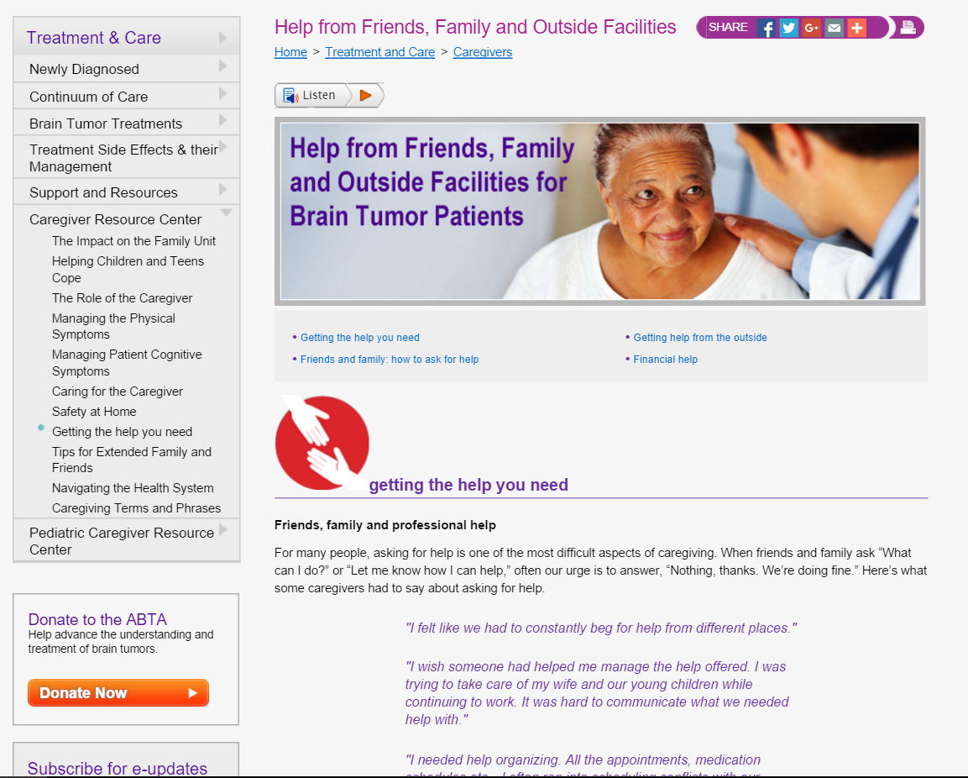
Personal fundraising
www.giveforward.com
www.youcaring.com
www.gofundme.com
How to ask for help from family and friends? Visit the ABTA website.
1. http://www.ssa.gov/compassionateallowances/conditions.htm
Notes:
There are also several websites to help families raise funds to cover medical costs. These include
[READ LIST]
It can be difficult to ask for these things from family and friends, but sometimes it is necessary. The ABTA website has a section on how to ask for help from family and friends.

Slide 24
SUMMARY
Notes:
I hope I’ve given you some ideas and resources you can use to help navigate the financial and legal aspects of a brain tumor diagnosis and treatment.

Slide 25
Going back to school or work
Bring up financial issues
Insurance
Know your policy
Maximize benefits
Investigate prescription assistance
Working
FMLA
Short- and long-term disability insurance
SSDI + Compassionate Allowance
ADA
Family and friends
Everyday help
Fundraising
Notes:
As a quick summary, we looked at some of the financial and legal repercussions of having a brain tumor and going through treatment.
The first thing to do is not shy away from bringing up financial issues with your care team. This will not affect your care, and most likely your care team has services and resources to help families deal with financial issues.
As far as insurance is concerned, know your policy and make sure you maximize the benefits you get by requesting a case manager from the insurance company and keeping careful records. Also, investigate the possibilities of prescription assistance, which is available to people with insurance and without.
Next, we discussed issues surrounding work. There are a variety of options based on whether the patient can work or not, or the caregiver needs to leave or cut down on work.
Most people will qualify for the 12 weeks of unpaid work allowed by the Family Medical Leave Act, which applies to both patients and caregivers.
Short- and long-term disability insurance may be available through your workplace, so be sure to investigate this option
Social Security Disability Insurance is another option available for most people who have been working, and people with certain kinds of conditions may be able to fast-track the process through the Compassionate Allowance program
Finally, the Americans with Disabilities Act provides protection for people who have the ability to continue working by requiring employers to provide accommodations for those who need them and not discriminate in hiring practices.
The last few things we discussed were the types of help people can get from family and friends. Some people have no problem asking for help, while for others, this can be difficult.

Slide 26
Contact information
Phone: 1-800-886-ABTA (2282)
Email: abtacares@abta.org
Online: www.abta.org
www.facebook.com/theABTA
www.twitter.com/theABTA
Notes:
There are many links and resources on the ABTA website for financial help. I hope this presentation served as a useful starting point to navigating your way through brain tumor diagnosis and treatment. For more information or resources, please call the ABTA CareLine or find information on the website at any time of the day or night.
Thank you for joining me today.

